Slide 1
press the next
developed by noojman
letters
Restart
numbers
Main Menu
letters
numbers
Retry
rate
quit

Slide 2
1
2
3
4
5
6
7
8
9
10
11
12
13
14
15
16
17
18
19
20
21
22
23
24
25

Slide 3
26
27
28
29
30
31
32
33
34
35
36
37
38
39
40
41
42
43
44
45
46
47
48
49
50

Slide 4
a
b
c
d
e
f
g
h
i
j
k
l
m
n
o
p
q
r
s
t
u
v
w
x
y
z

Slide 5
A
B
C
D
E
F
G
H
I
J
K
L
M
N
O
P
Q
R
S
T
U
V
W
X
Y
Z

Slide 6
Keep pressing the next
number as fast as you can!
Keep pressing the next
letter as fast as you can!

Slide 7
1
a
Z
50

Slide 8
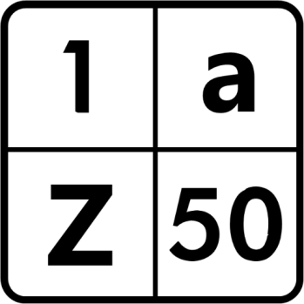
press the next

Slide 9
press the next

Slide 10
press the next

